Slide 1

CSE310: Programming in Java
Topic: Variables & their Scope

Slide 2
Outlines
[Expected Time: 1 Hours]
Variables and their Scope
  Local Variable
  Instance Variable
  Class Variable

Slide 3
Variables
Variable are the data members or the fields defined inside a class.
There are three types of variables:
  Local Variable
  Instance Variable
  Class Variable

Slide 4
Local Variable
Local variables are those data members which are declared in methods, constructors, or blocks.
They are created only when the method, constructor or block is executed and destroyed as soon as the execution of that block is completed.
So the visibility of local variables is inside the block only, they can’t be accessed outside the scope of that block.

Slide 5
Important
Access modifiers are NOT ALLOWED with local variables.
Local variables are created in STACK.
Default value is NOT ASSIGNED to the local variables in Java.

Slide 6
Instance Variables
Variables which are declared in a class, but outside a method, constructor or any block are known as instance variables.
They are created inside the object in heap.
Each object has its own set of instance variables and they can be accessed/modified separately using object reference.

Slide 7
Instance variables are created when an object is created with the use of the 'new' keyword and destroyed when the object is destroyed.
Access modifiers can be used with instance variables.
Instance variables have default values.
For numbers the default value is 0,
for Booleans it is false
and for object references it is null.

Slide 8
Class Variable
Class variables are also known as static variables.
Variable which are declared in a class, but outside a method, constructor or a block and qualified with ‘static’ keyword are known as class variables.
Only one copy of each class variable is created, regardless of how many objects are created from it.
Static variables can be accessed by calling with the class name.
ClassName.VariableName

Slide 9
Static variables are created with the start of execution of a program and destroyed when the program terminates.
Default values are same as instance variables.
A public static final variable behaves as a CONSTANT in Java.
Static variables can be initialized using static block also.

Slide 10
Variable Initialization
Local variables must be initialized explicitly by the programmer as the default values are not assigned to them where as the instance variables and static variables are assigned default values if they are not assigned values at the time of declaration.

Slide 11
Brainstorming 1
What will be the output of the following Program?
class VariableDemo
{
public static void main(String [] rk)
{
public int x = 10;
System.out.print(x);
}
}

Slide 12
Brainstorming 2
What will be the output of the following Program?
class VariableDemo
{
static int x;
public static void main(String [] rk)
{
int x;
System.out.print(x);
}
}

Slide 13
Brainstorming 3
What will be the output of the following Program?
class VariableDemo
{
static int x;
public static void main(String [] rk)
{
int x;
System.out.print(VariableDemo.x);
}
}

Slide 14


Slide 15
Data Types in Java
Data types represent the different values to be stored in the variable. In java, there are two types of data types:
Primitive data types
Non-primitive data types

Slide 16
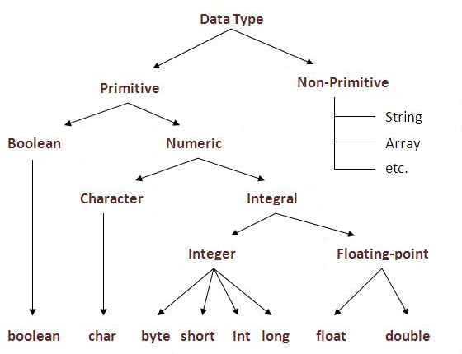
Data Types in Java

Slide 17
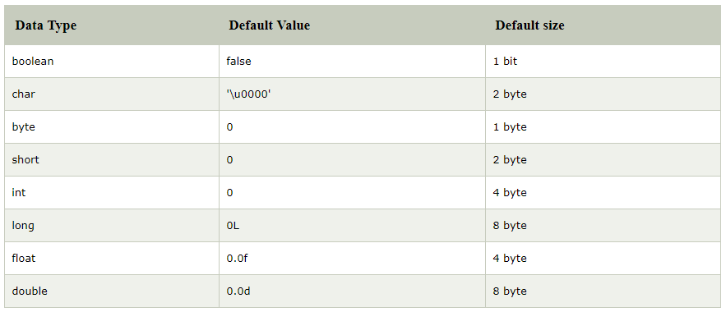

Slide 18
Java Scanner class
The Java Scanner class breaks the input into tokens using a delimiter that is whitespace bydefault. It provides many methods to read and parse various primitive values.
Java Scanner class is widely used to parse text for string and primitive types using regular expression.
Java Scanner class extends Object class and implements Iterator and Closeable interfaces.

Slide 19
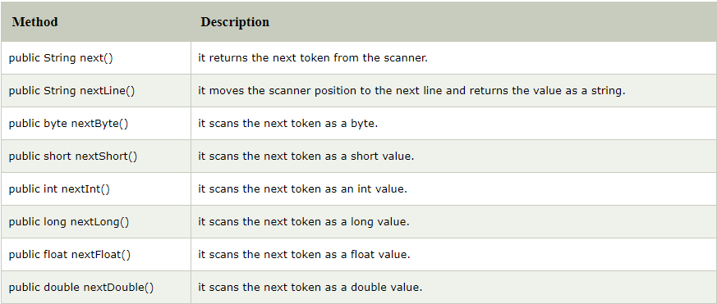
Commonly used methods of Scanner class

